Slide 1

WEBSITE TRAFFIC ANALYSIS
Hiral Vyas
Senior Data Engineer

Slide 2
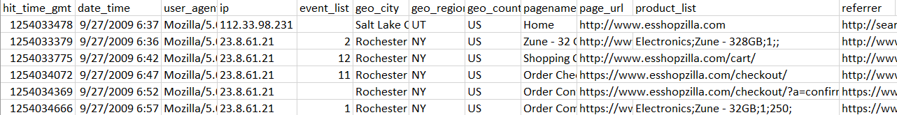
THE PROBLEM
How much revenue is the client getting from external Search Engines, such as Google, Yahoo and MSN, and which keywords are performing the best based on revenue?
Input : Hit Level Data
Output:
- Search Engine Domain (i.e. google.com)
- Search Keyword (i.e. "Laffy Taffy")
- Revenue (i.e. $12.95)

Slide 3
Data Preprocessing
Missing Product List (Filled using [;])
Multiple Products in a single row (split by ,)
Missing merchandizing_evar column value in Product List(considered a column in case it’s present in new columns)
No Separate Product List Columns (split by ;)
Extracting keywords and referrer host from URL (used urllib library to parse the query string)
Keywords are lowercased to group into one.

Slide 4
ASsumptions
Each IP has only one session.
That means max of one purchase/checkout (can have multiple products) per ip.
Identification of multiple session will need development of module which uses timeseries.
I am making this assumption to avoid additional complexities and respect the time limit of this assignment.
Each session can have at max one source referrer.
If there are multiple referrer (or URL's with multiple domains containing search keyword) the first one would be taken.
Event type "1" indicates a purchase.
And has all the revenue related info. Any revenue related info outside of this event type will be lost.
Total revenue has revenue for the respective product in product line

Slide 5
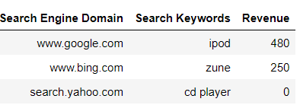
RESults
Tab Separated File showing details of popular search keywords based on revenue

